Slide 1
Implementing LACE at Neuman Memorial
Laura Hickerson
Dan Slater
Analytics Dept

Slide 2
Today’s Agenda
Concern about 30-day readmissions
Introduce LACE index as a decision making tool
Potential benefits to Neuman Memorial and our patients
Executive Committee support for LACE initiative
Notes:
Why have we gathered you all here today:
We’re going to discuss Concern about 30-day readmissions
Introduce LACE index as a decision making tool related to identifying high risk patients.
Discuss the potential benefits to Neuman and our patients
We’re going to discuss your role, as the Executive Committee, in the effective implementation of the LACE index.

Slide 3
Areas of Concern - 30 Day Readmissions
Our organization: Jan 1, 2014 – Nov 18, 2014 5169 readmissions.
2009 All-Cause CMS readmission data: expected cost for single readmission $11,200 (Rizzo 2013).
Readmissions are reportable, and public perception of care is very important
Estimated savings for the average 30-day readmission avoided: ~$9000 (Carey & Stefos 2016).
Notes:
Why are concerned about our readmission rates?
-For our organization, Between Jan 1, 2014 – Nov 18, 2014 we have had 5169 readmissions.
-Data from the Healthcare Cost Utilization Project, for all cause CMS-tacked readmission data for 2009: expected cost for single readmission $11,200 (Rizzo 2013). - Readmission data is publically reported, (and whether or not these data are indicative of care quality), public perception of care is critical piece or our business.
- One recent research model on projected savings from readmission reduction Estimated savings for the average 30-day readmission avoided: approximately $9000 (Carey & Stefos 2016).

Slide 4
Business as Usual
Missed opportunity to identify high risk patients for intervention
Missed opportunity to improve care quality
Readmissions cause patient burden & $$$ cost regardless of penalties
Other hospitals have implemented LACE index with success
Notes:
The LACE tool presents an opportunity to identify high risk patients for intervention.
If we continue without addressing readmission concerns,

Slide 5
Common factors associated
with Preventable Readmissions Auerbach et al. 2016
Failure to relay information to outpatient care (continuity of care)
Patient lack of awareness of who to contact post discharge (6.2% of readmits)
Inability to keep appointments (8.3 % of readmits)
Lack of discussions about care goals (3.84% of admissions)
Pilot Areas for Intervention
Notes:
Studies have identified common factors associated with preventable readmissions, such as …
In conjunction with LACE implementation, we feel these 4 areas in particular would be a good fit for pilot areas of intervention after identifying high risk patients.

Slide 6
Initial evaluation of LACE at Neuman Memorial
Scoring based on data we can extract from our EHR
Length of stay
Acuity of Admission
Comorbidities
ER → Admission

Slide 7
Model based on 2014 data
39,701 hospital encounters from January 2014 through November 2014
34,532 index admissions
5,169 readmissions within 30 days (15% readmission rate)
(move to later discussion?) Each 1% reduction ~ $100k ($450k?)
Model developed from 90% of data, randomly selected
Tested on 10%
Logistic regression

Slide 8
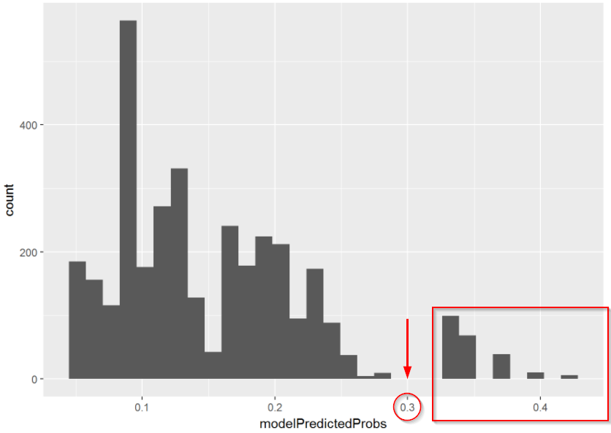
Focus interventions on the highest risk group

Slide 9
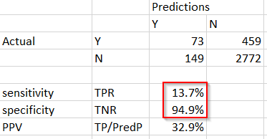
Results
LAE model, omitting C
We are missing comorbidity data pending database population
Model should improve with C data
13.7% sensitivity should improve
94.9% specificity
(compare to Low et al, 2015)
9.3% sensitivity
95.8% specificity

Slide 10
Potential Impact
33% of identified patients will be readmitted in 30 days
25% of readmissions are deemed preventable overall
Active areas of research
What % of readmissions are preventable for this high risk subgroup?
How effective can interventions be?
Sensitivity and PPV are expected to improve with more comorbidity data
Every 1% reduction ~ $500,000

Slide 11
Ongoing Executive Committee Sponsorship
Readmission reduction program requires support and coordination across organization
Analytics providing metric but care providers will execute
Pilot intervention program needs to be designed
Stakeholders include Finance, Hospitalists, Nursing, Outpatient Care, Quality, Pharmacy
Executive Committee sponsorship is needed to help bring stakeholders together

Slide 12
Recommendations
Develop Comorbidity data
Improve model
Work with stakeholders to develop intervention plans
Seek IRB approval for pilot program

Slide 13

Thank you!
Analytics Group
Neuman Memorial Hospital
Our Founder

Slide 14
References
Auerbach AD, Kripalani S, Vasilevskis EE, Sehgal N, Lindenauer PK, Metlay JP, et al. Preventability and Causes of Readmissions in a National Cohort of General Medicine Patients. JAMA Intern Med. 2016 Apr;176(4):484–93.
Low et al., BioMed Research International Volume 2015 (2015) http://dx.doi.org/10.1155/2015/169870
Carey and Stefos, Cost of Hospital Admissions: Evidence from the VA (Healthcare Management Science, 2016, No. 19, v.3)
Rau, Kaiser Health News, Aug 2, 2016 accessed Aug 24, 2017 http://khn.org/news/more-than-half-of-hospitals-to-be-penalized-for-excess-readmissions/
Rizzo, E. Six stats on the cost of readmissions for CMS-tracked conditions. Beckers Infection Control & Clinical Quality. Dec 12, 2013. http://www.beckershospitalreview.com/quality/ 6-stats-on-the-cost-of-readmission-for-cms-tracked-conditions.html
van Walraven C, Bennett C, Jennings A, Austin PC, Forster AJ. Proportion of hospital readmissions deemed avoidable: a systematic review. CMAJ. 2011 Apr 19;183(7):E391-402.

